Slide 1

Project 1: Covid-19 Mortality and Age Groups
Anas Ziady
Shriram Sreedhar
Sandra Martinez

Slide 2
Project Description/Outline
Covid-19 mortality and older age groups seems to be related. Can we clearly see a correlation between those two parameters across 5 different states within the United States?
Definition: Older age groups range from 55 years old and above. The populations are going to be divided between working (55 to 64 years old) and non-working* (65 years old and above) age ranges.
*Some people might be working within this age group, but it might not be a significant portion of the population.

Slide 3
Research Questions to answer
H0: Covid-19 mortality is not correlated to older age groups.
HA: Covid-19 mortality is correlated to older age groups.

Slide 4
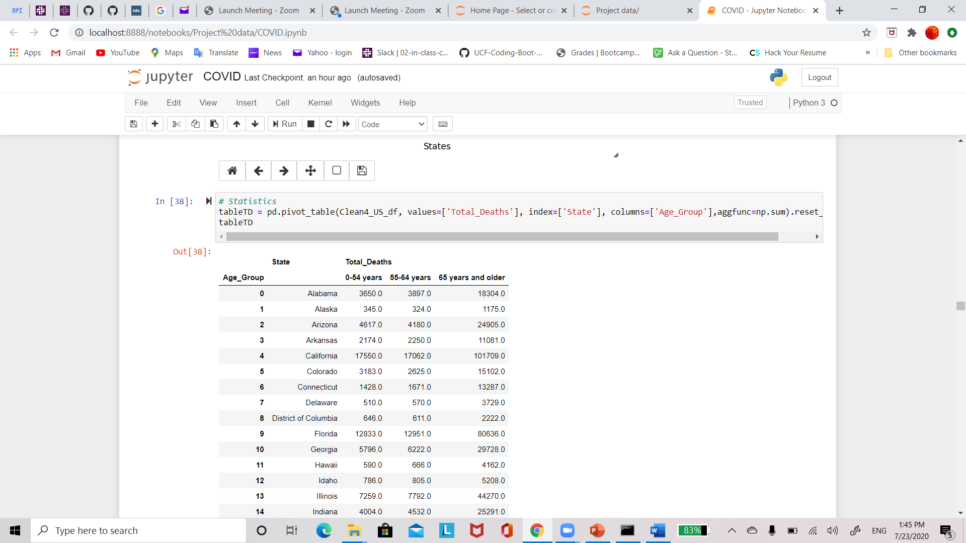
Data Clean Up
The most time-consuming part of the project is finding reliable data and cleaning it up.
We used multi index pivot tables to group part of the data.

Slide 5

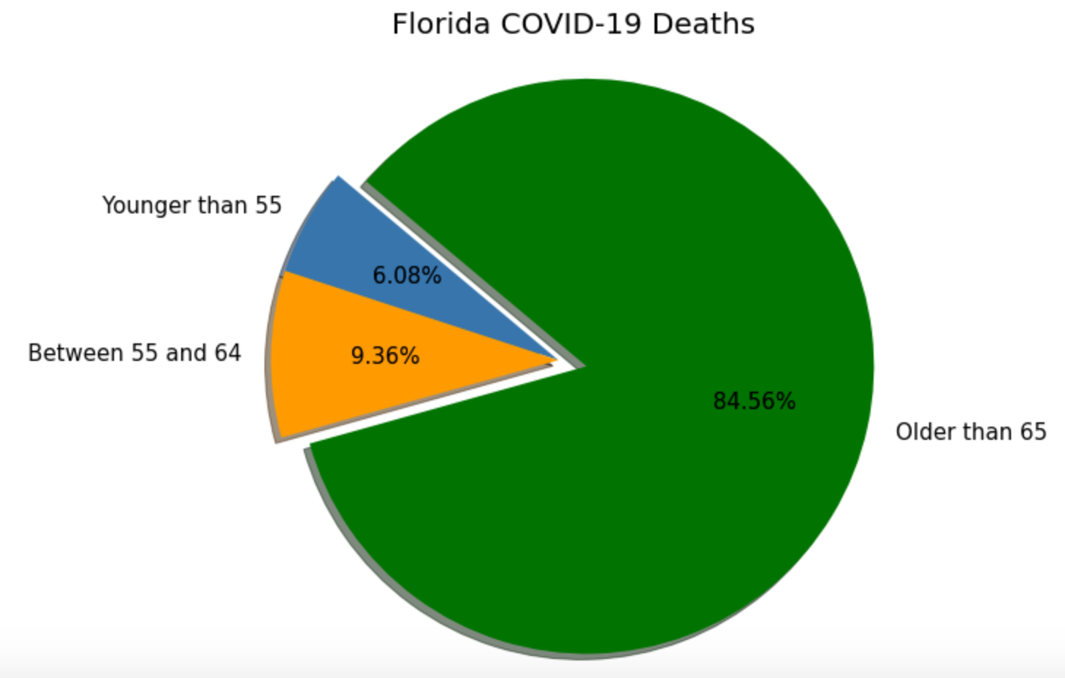
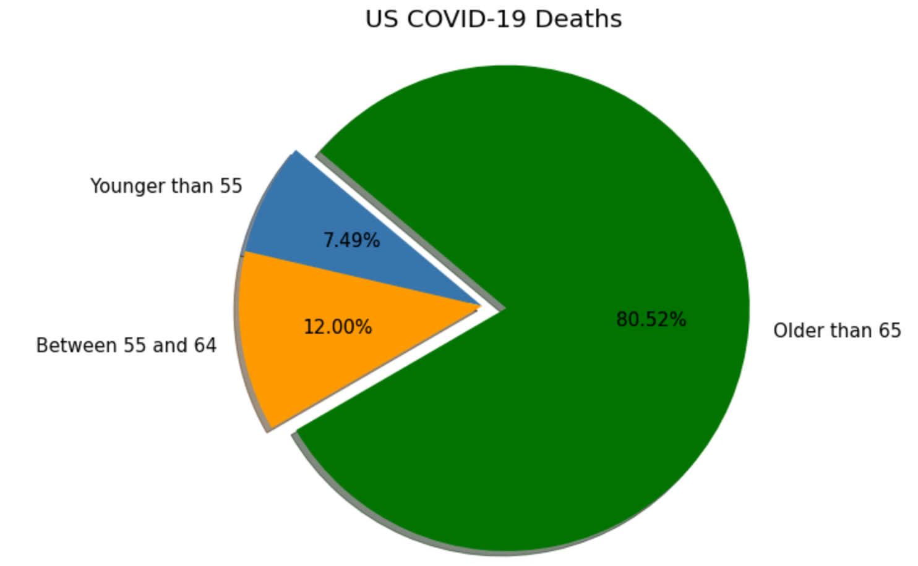
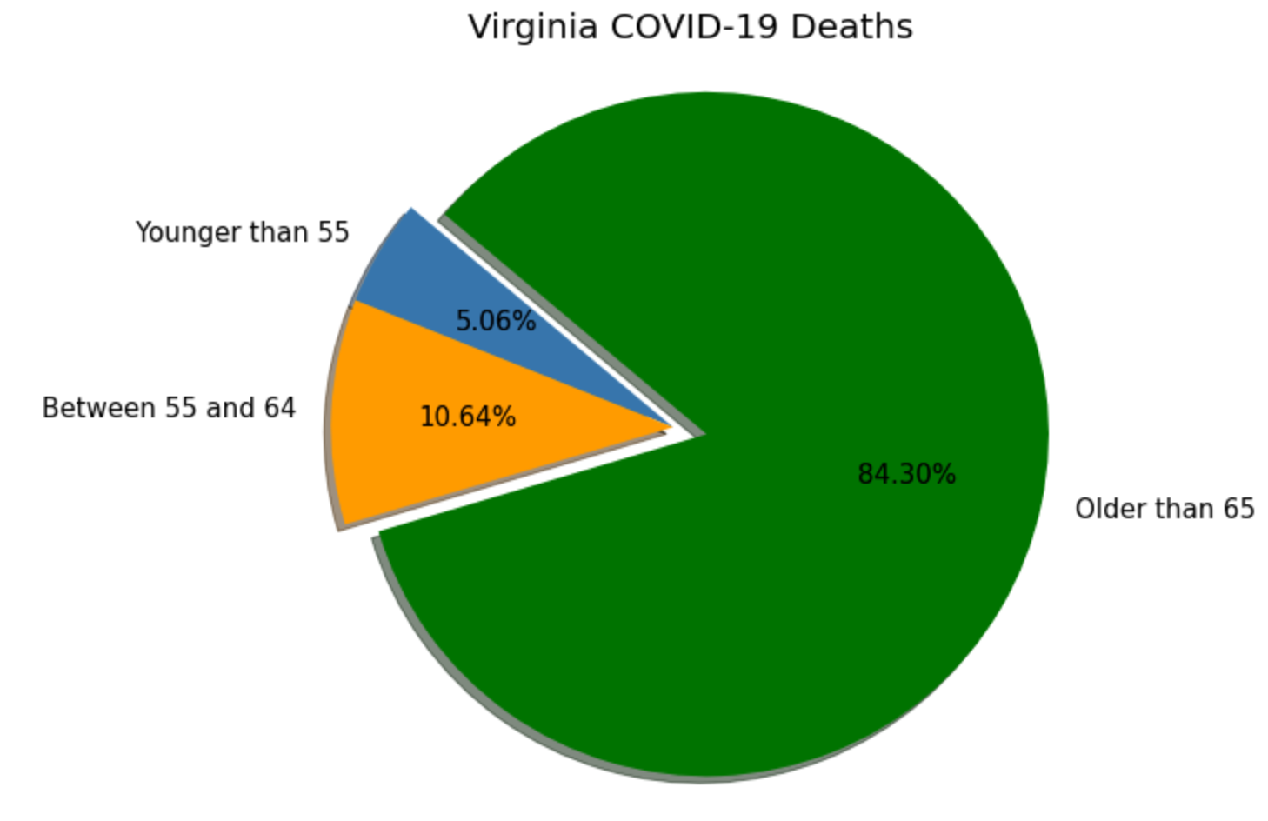

Pie Charts

Slide 6
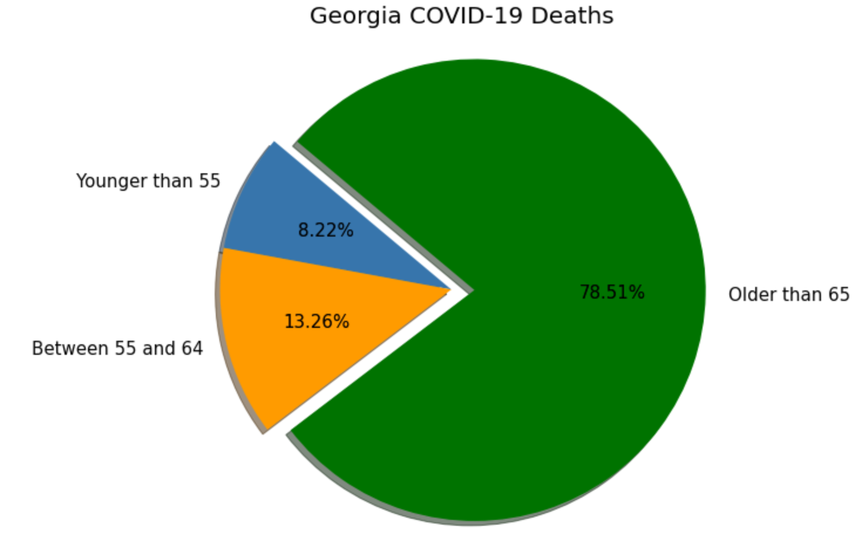
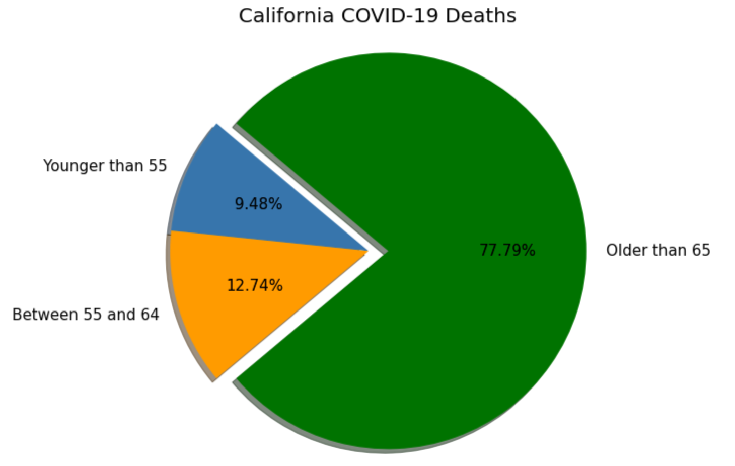
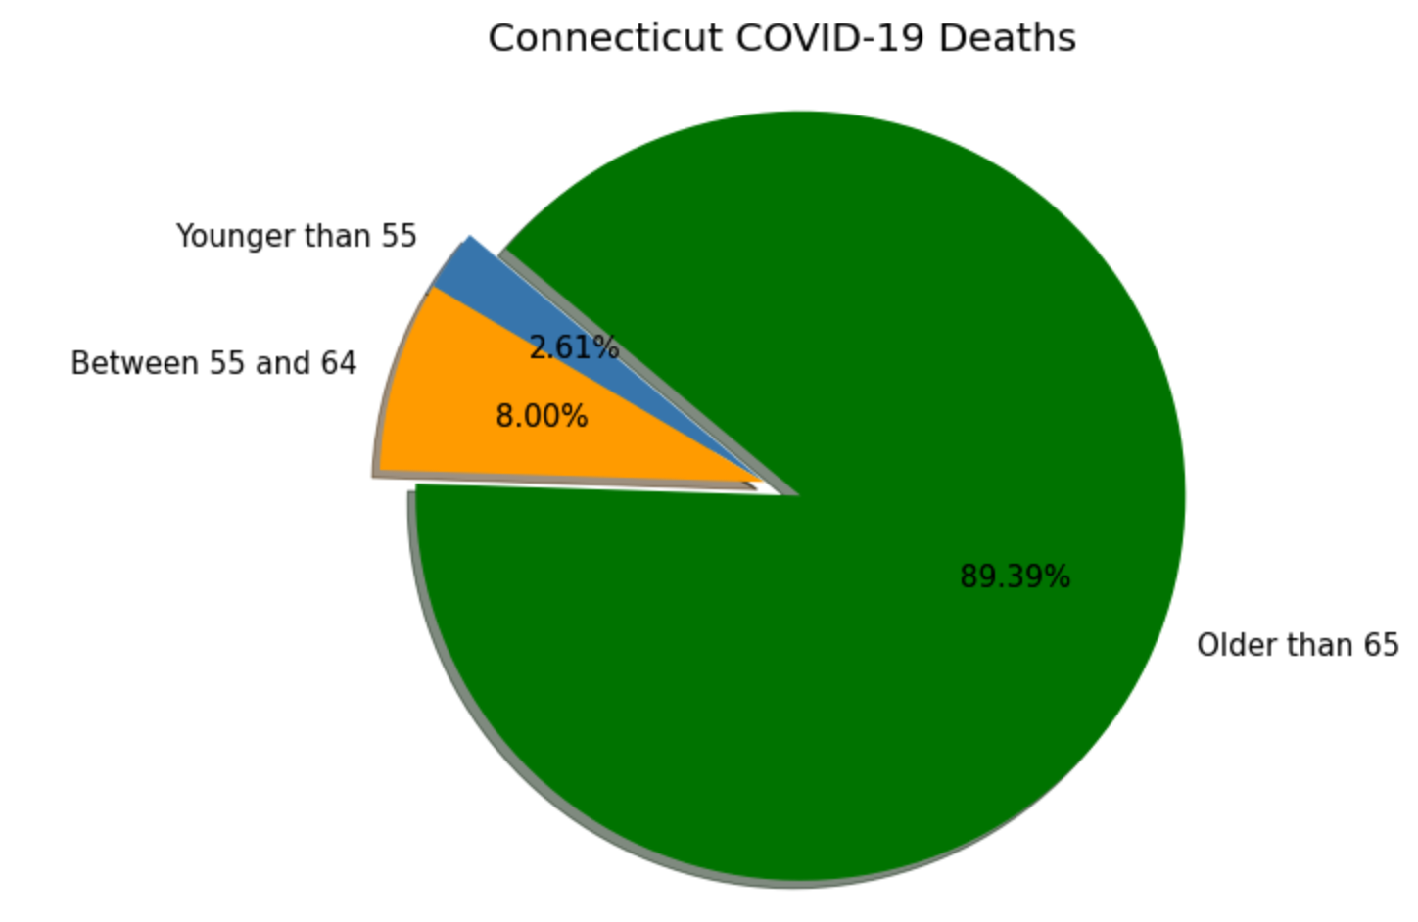
Pie Charts

Slide 7
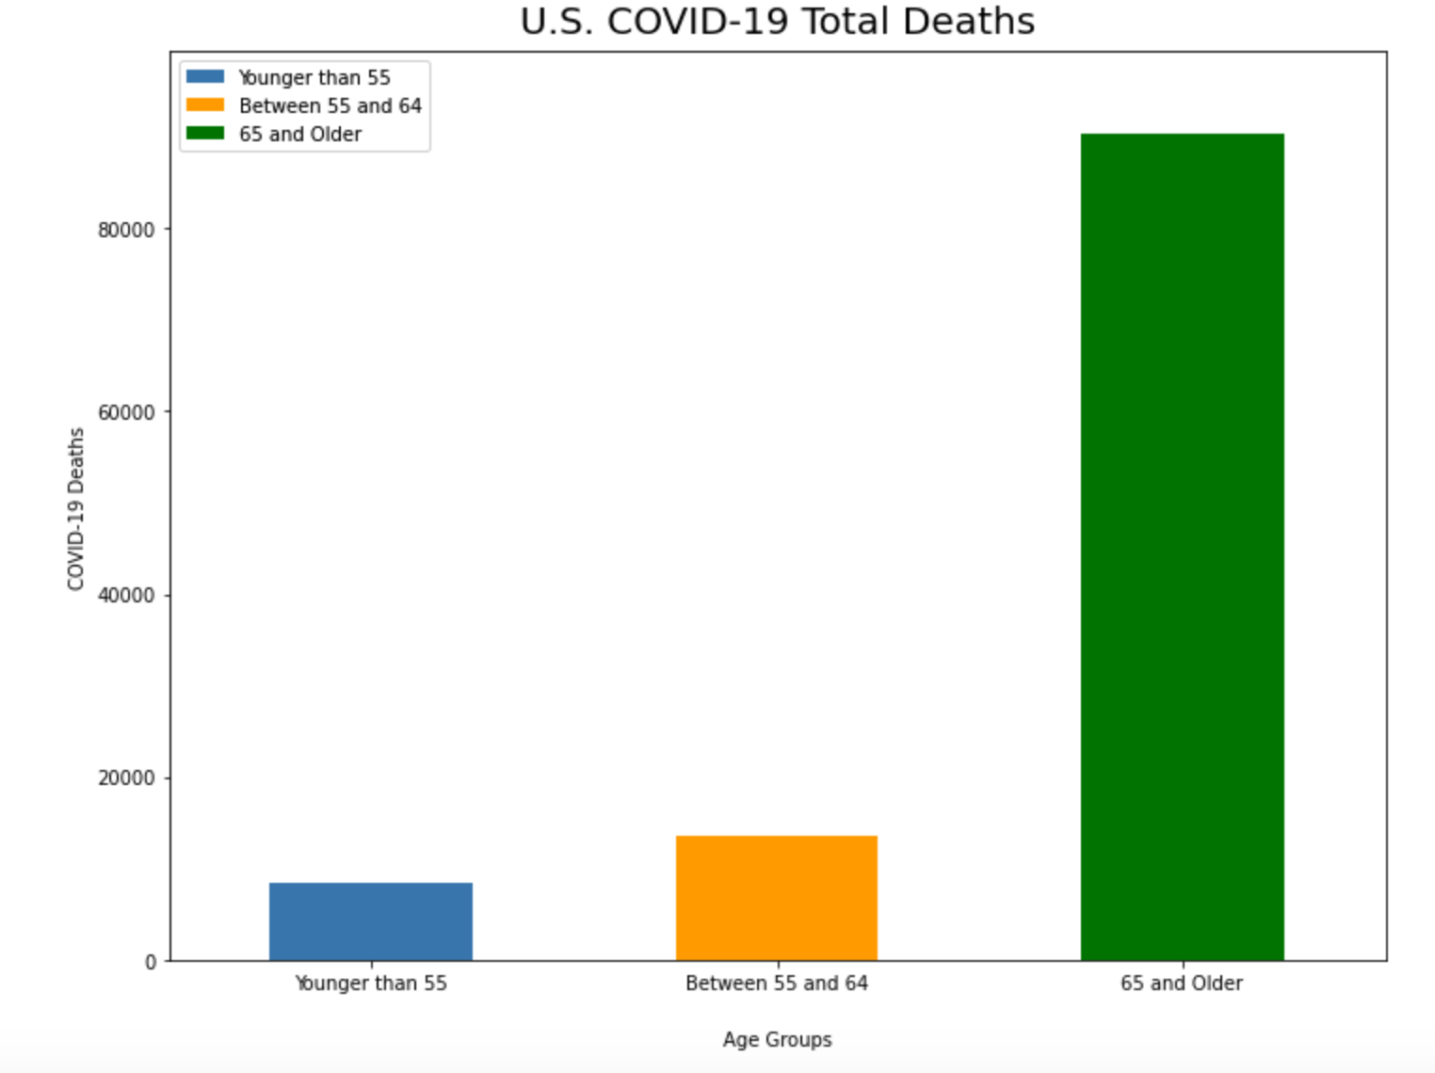

Slide 8
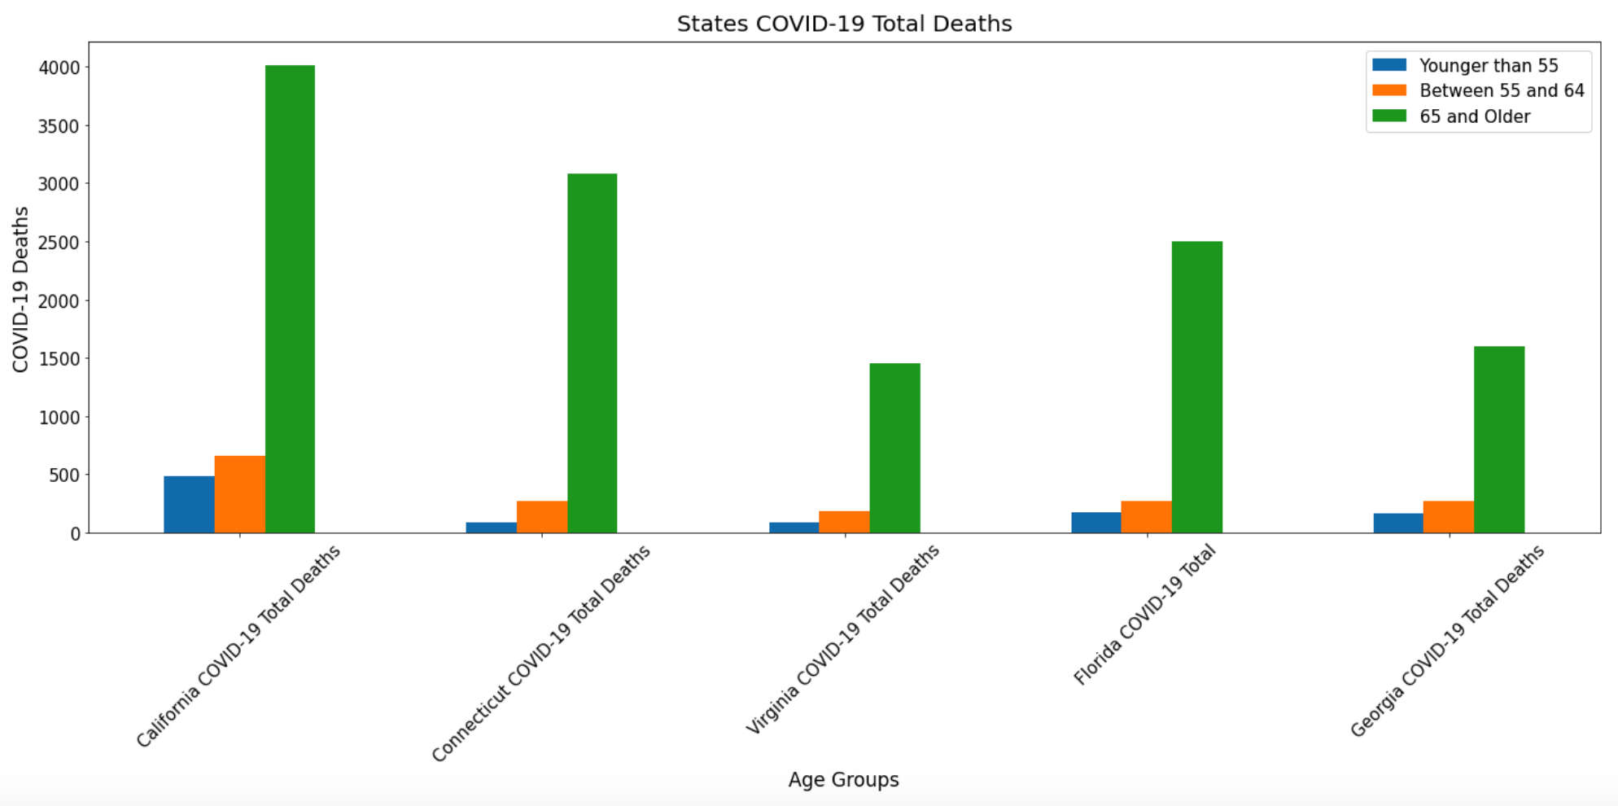

Slide 9
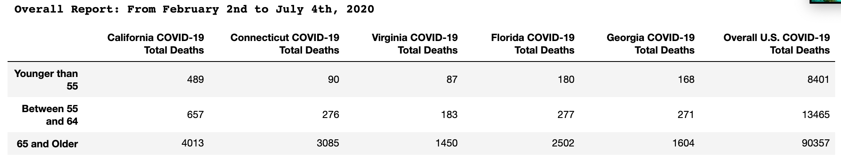
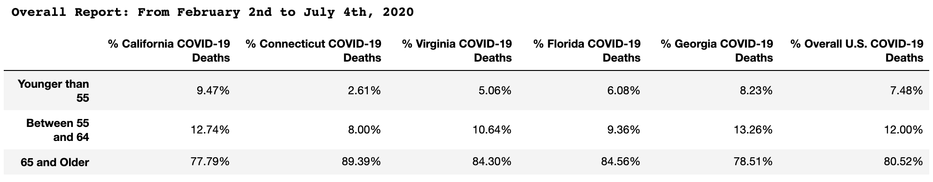
Overall US Report

Slide 10
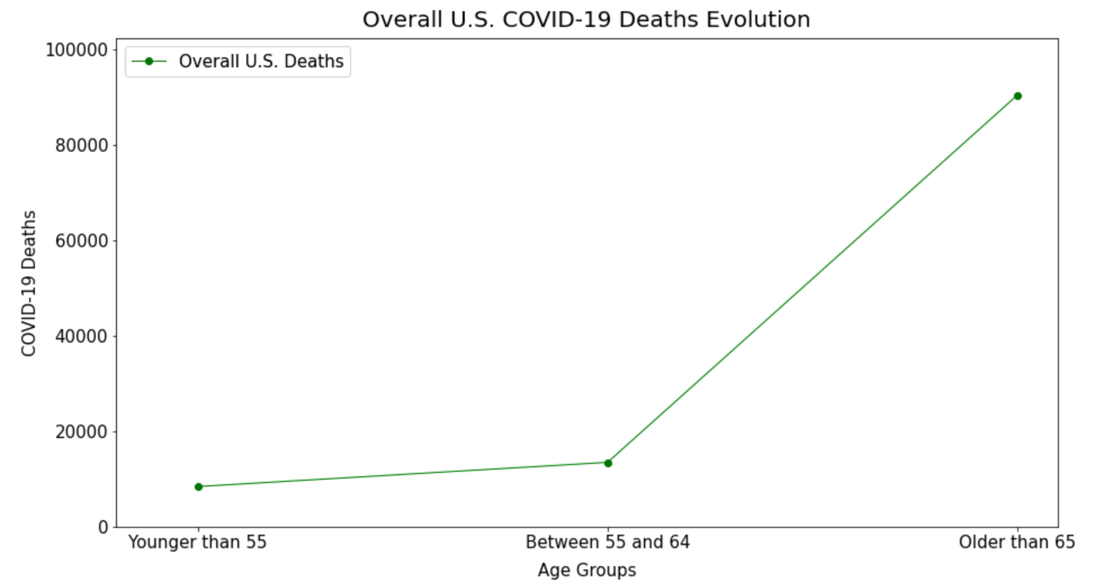

Slide 11
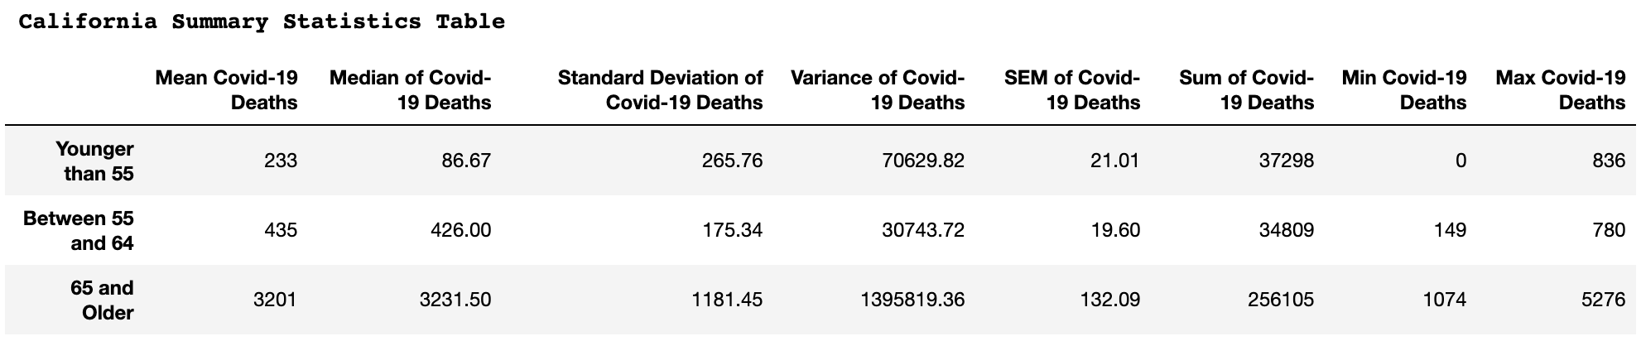

Summary Statistics per State

Slide 12
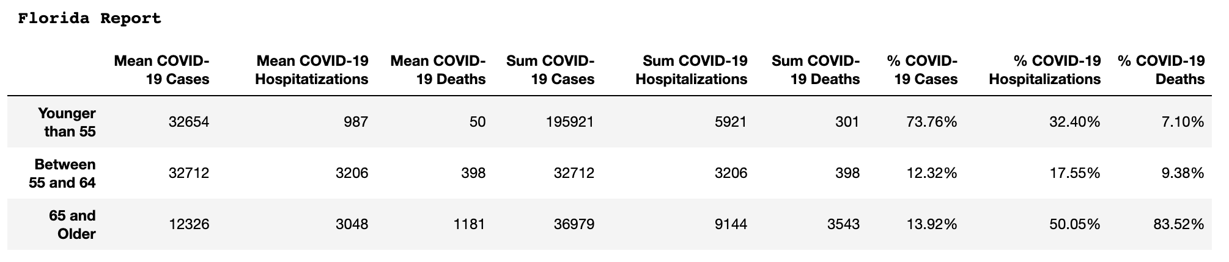
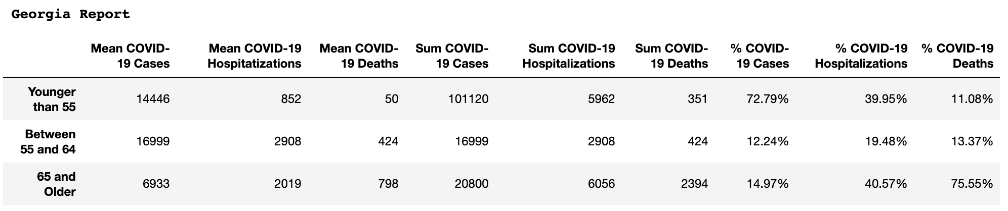
Summary Statistics per State

Slide 13
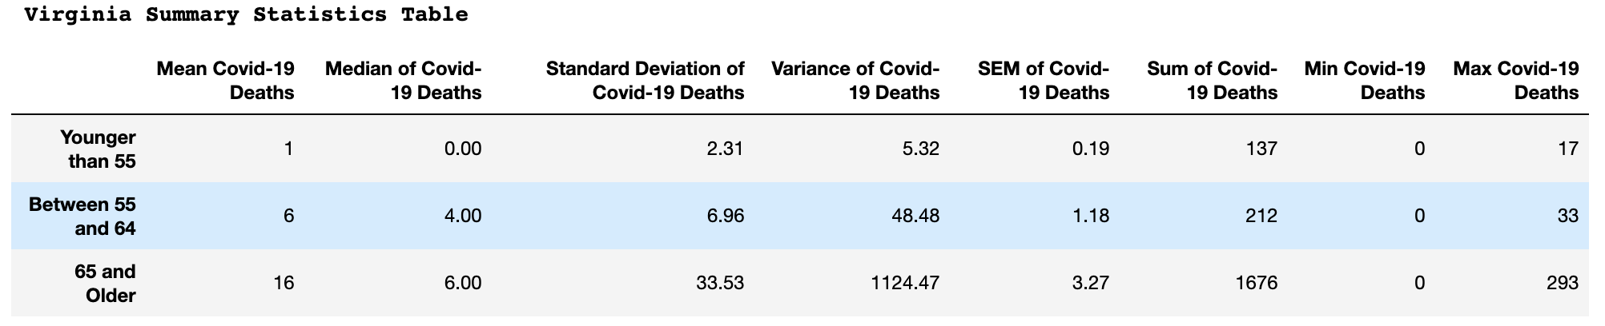

Summary Statistics per State

Slide 14
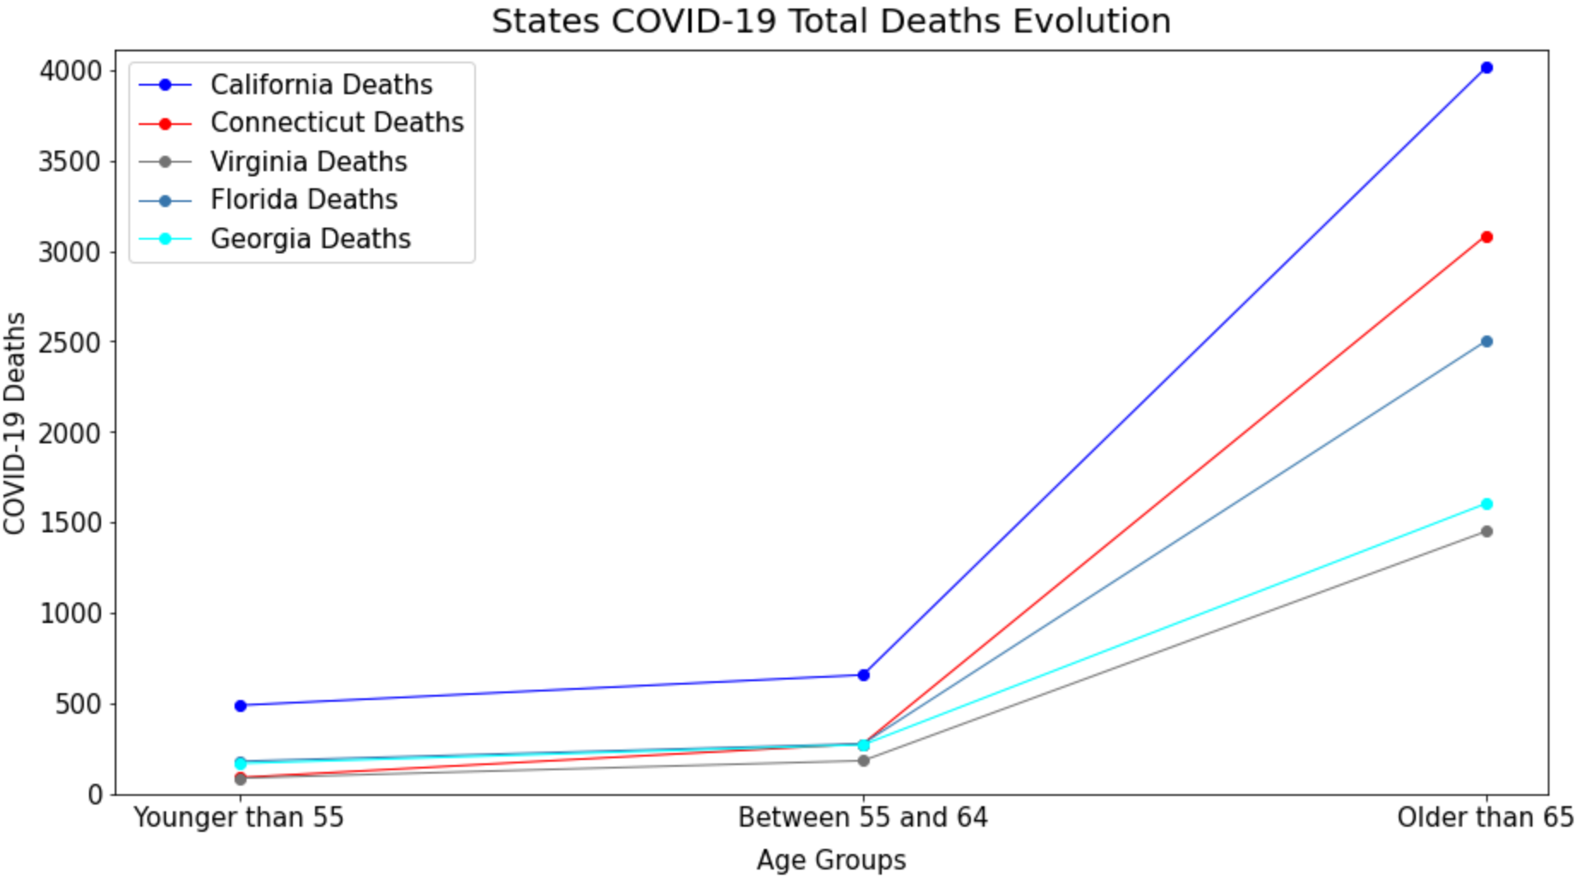

Slide 15
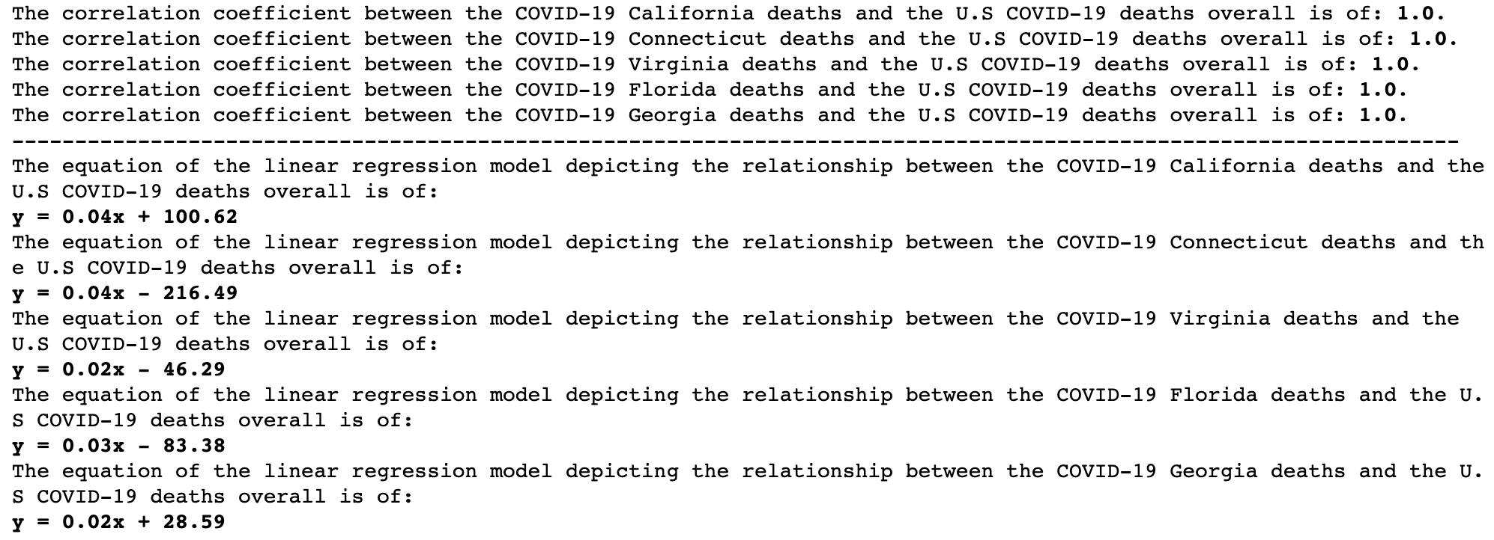
Correlations per State

Slide 16
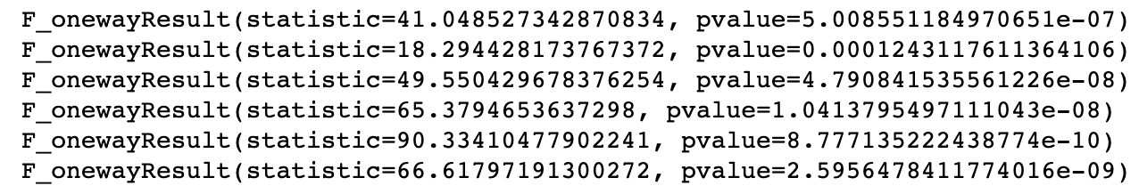
Anova
California
Connecticut
Virginia
Florida
Georgia
US Overall

Slide 17
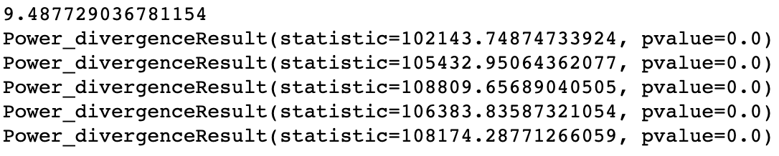
Chi-Square Test
California
Connecticut
Virginia
Florida
Georgia

Slide 18
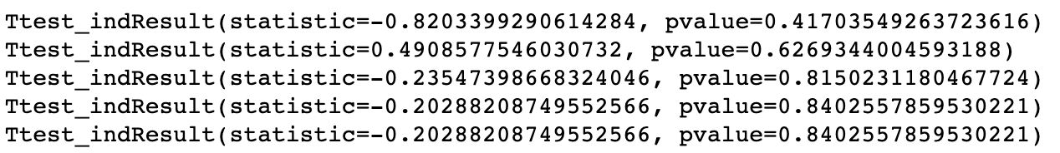
T-test
California
Connecticut
Virginia
Florida
Georgia

Slide 19
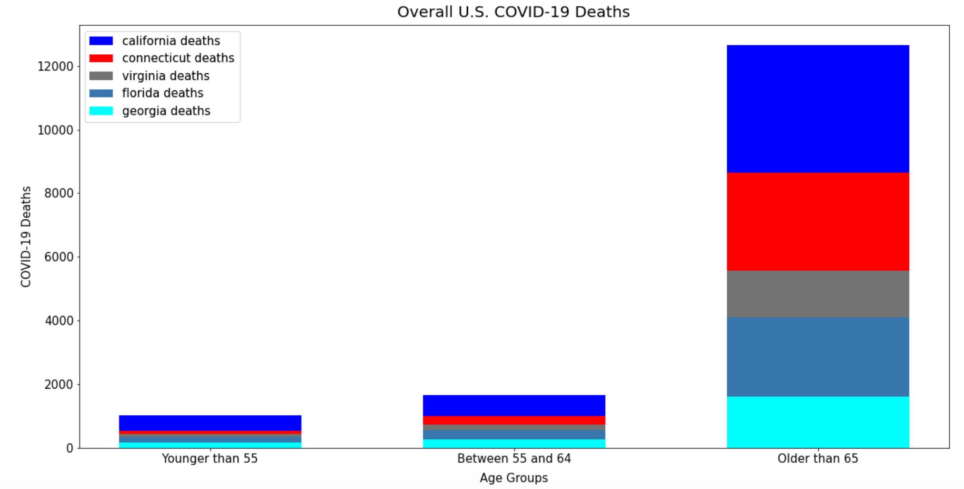

Slide 20
Correlations per Age Group
Pearson correlation coefficient between “COVID-19 Deaths” and “Total US Deaths”
Age Groups
0-54 years:0.66
55-64 years: 0.64
65 years and older: 0.66
Pearson correlation coefficient between "Pneumonia_and_COVID-19_Deaths" and "Total Deaths”
Age Groups
0-54 years:0.99
55-64 years: 1.00
65 years and older: 1.00

Slide 21
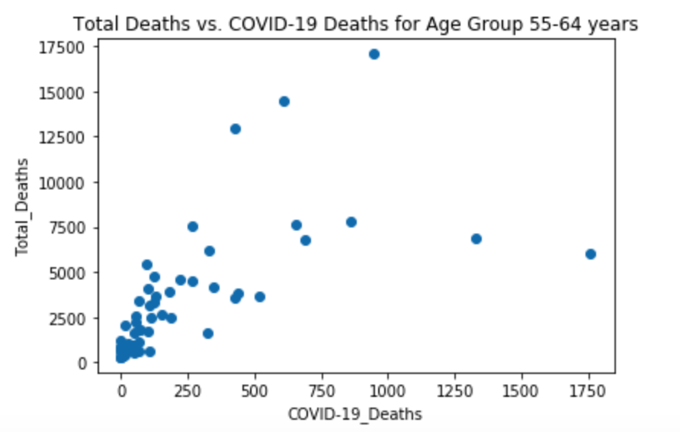
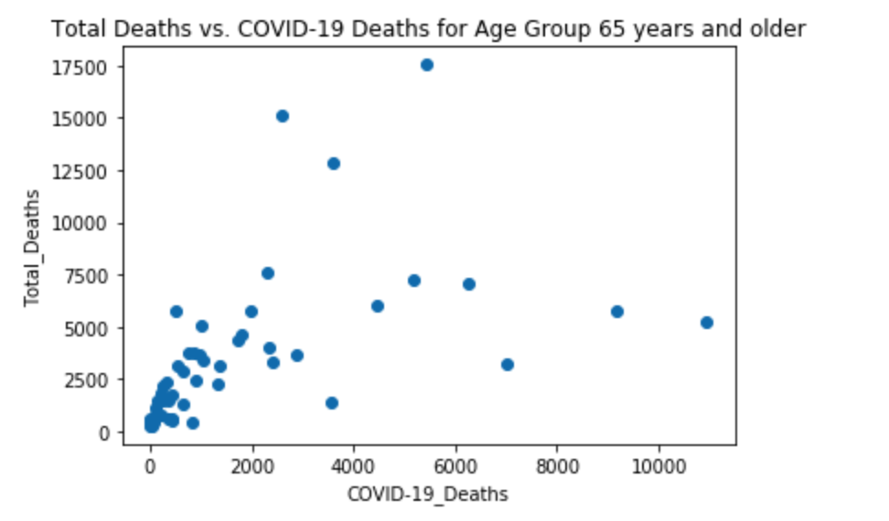
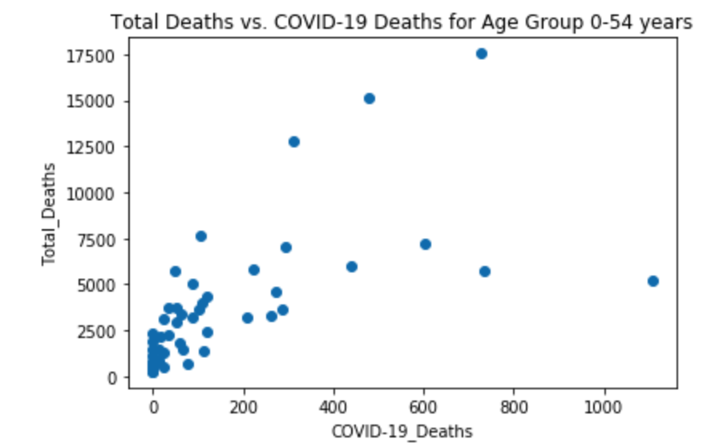
Scatter Plots

Slide 22
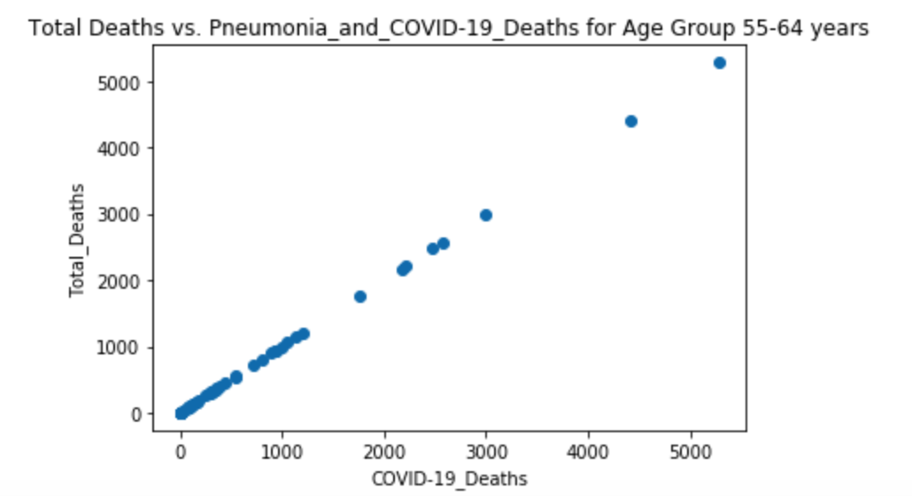
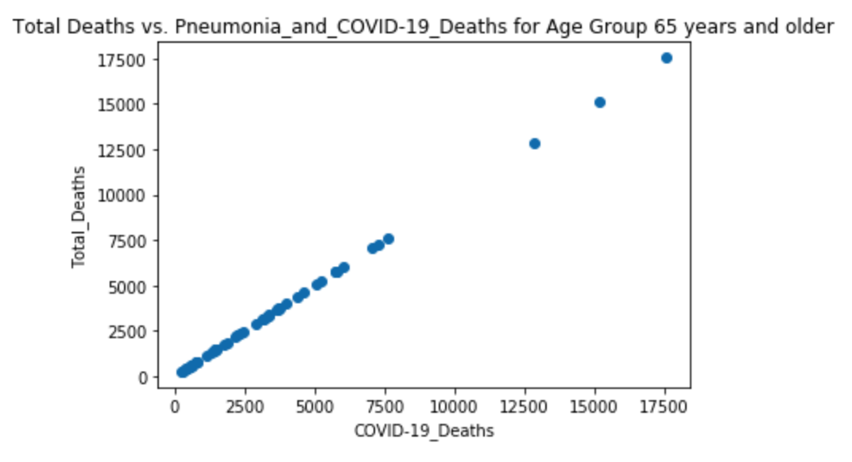
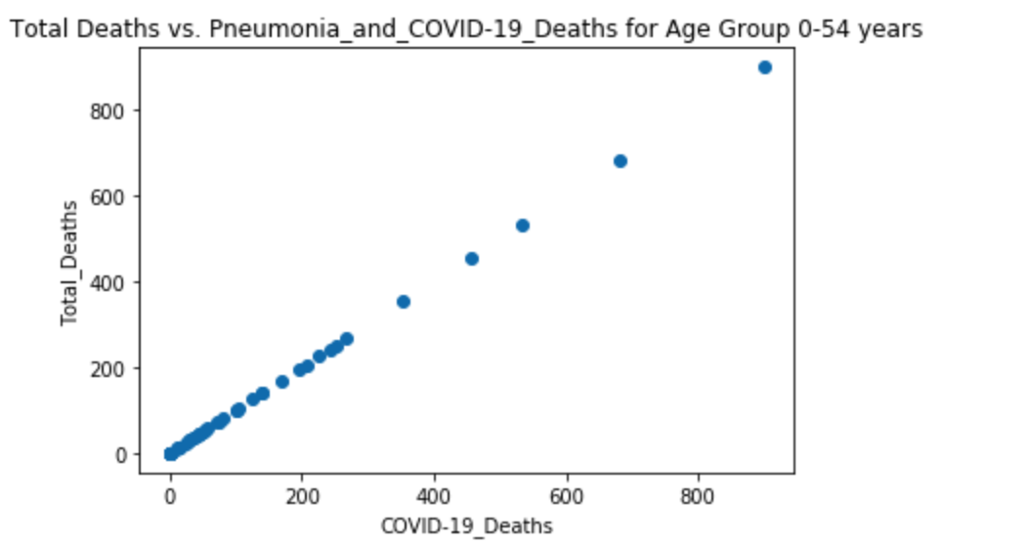
Scatter Plots

Slide 23
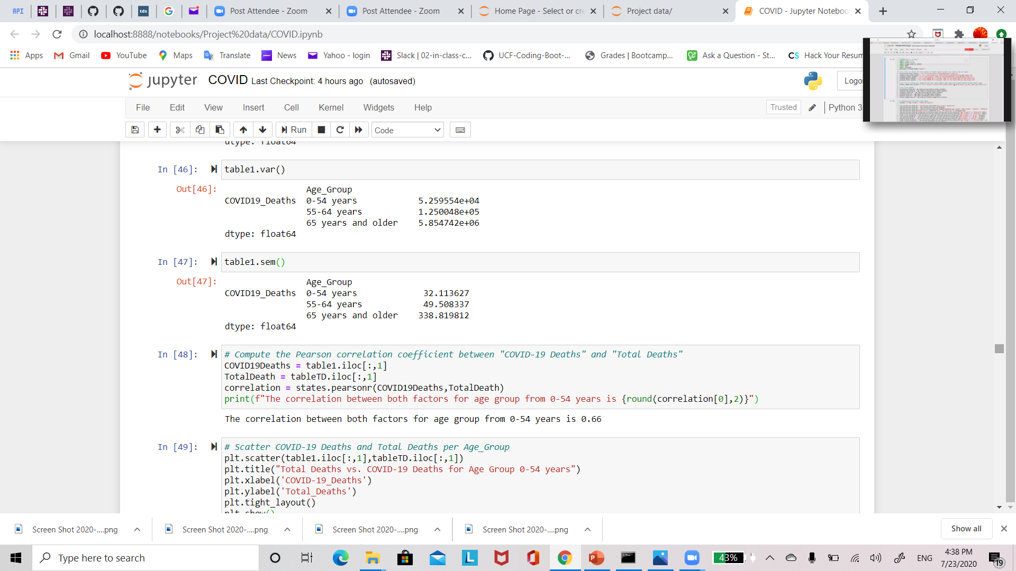
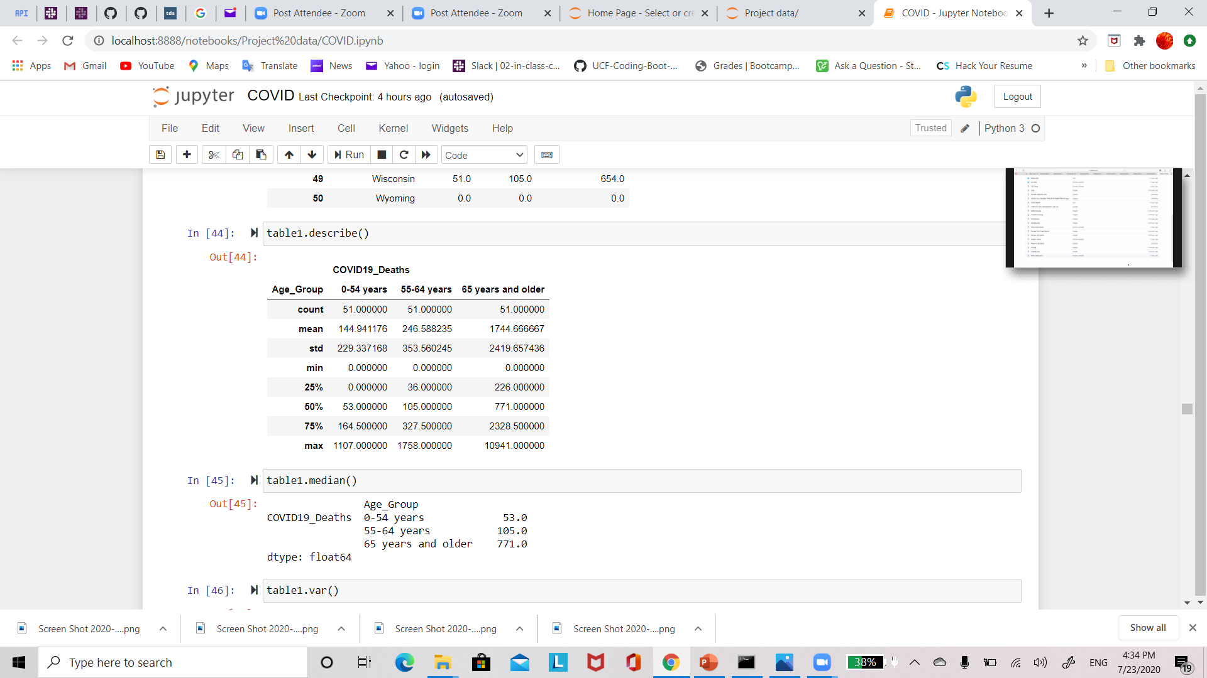
Descriptive Stats for COVID-19 Deaths

Slide 24
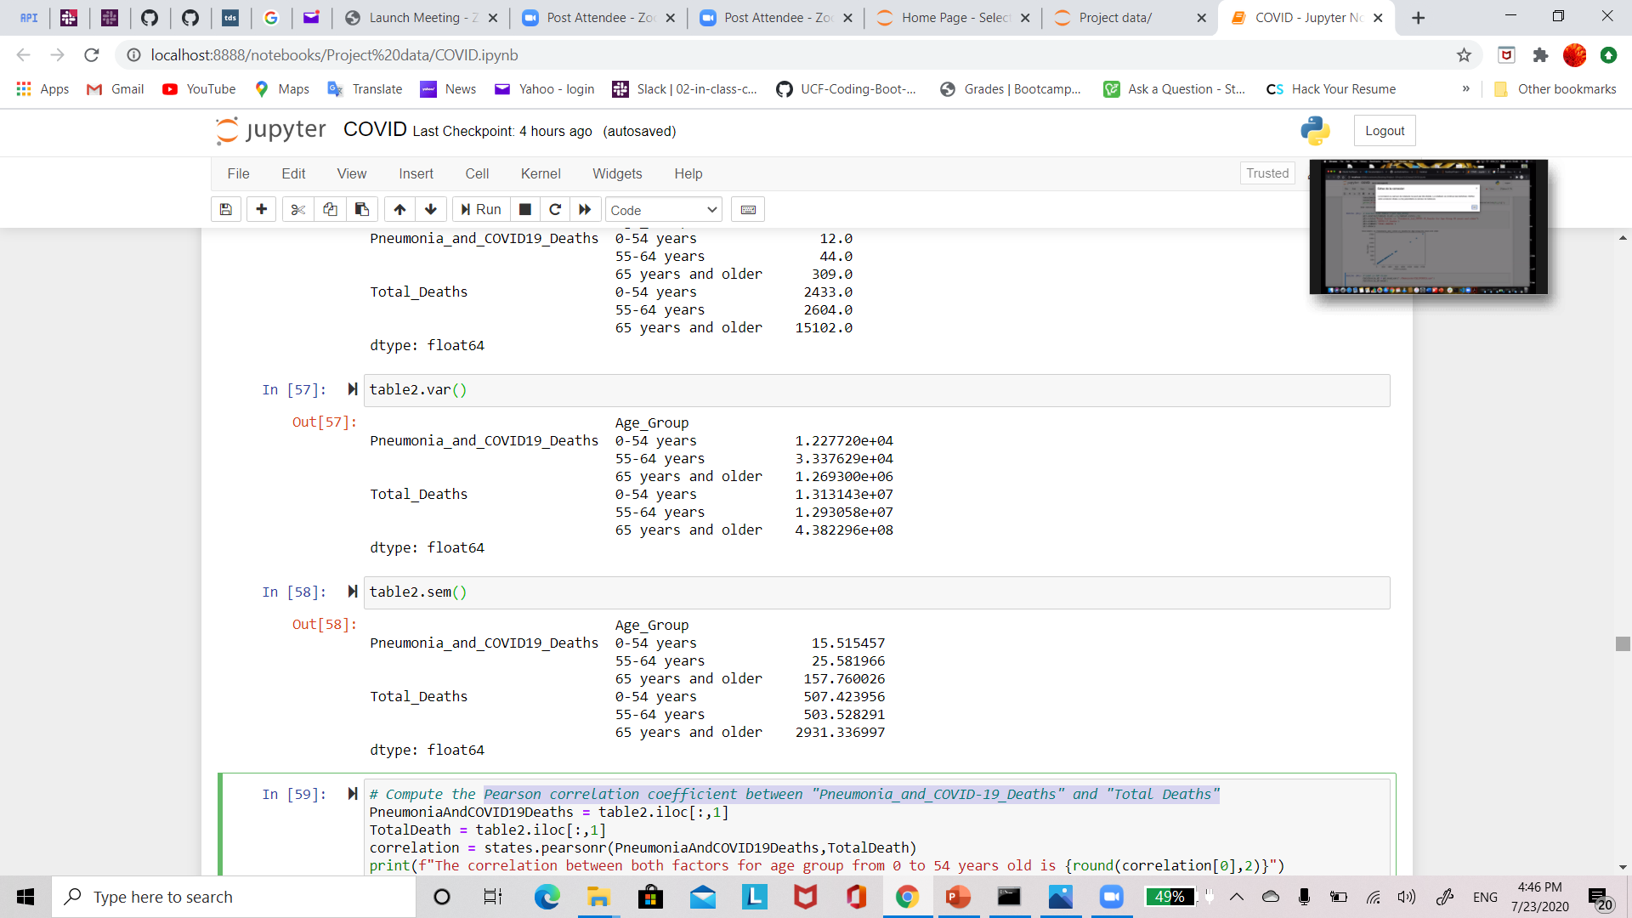
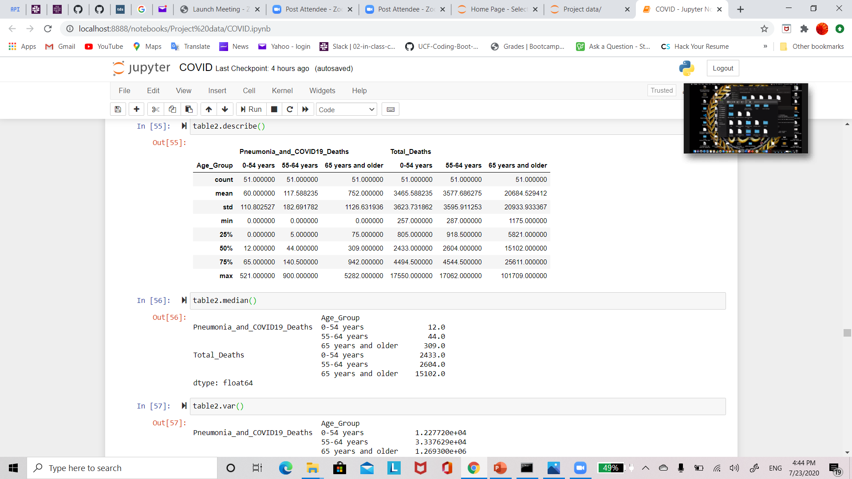
Descriptive Stats for COVID-19 and Pneumonia Deaths

Slide 25
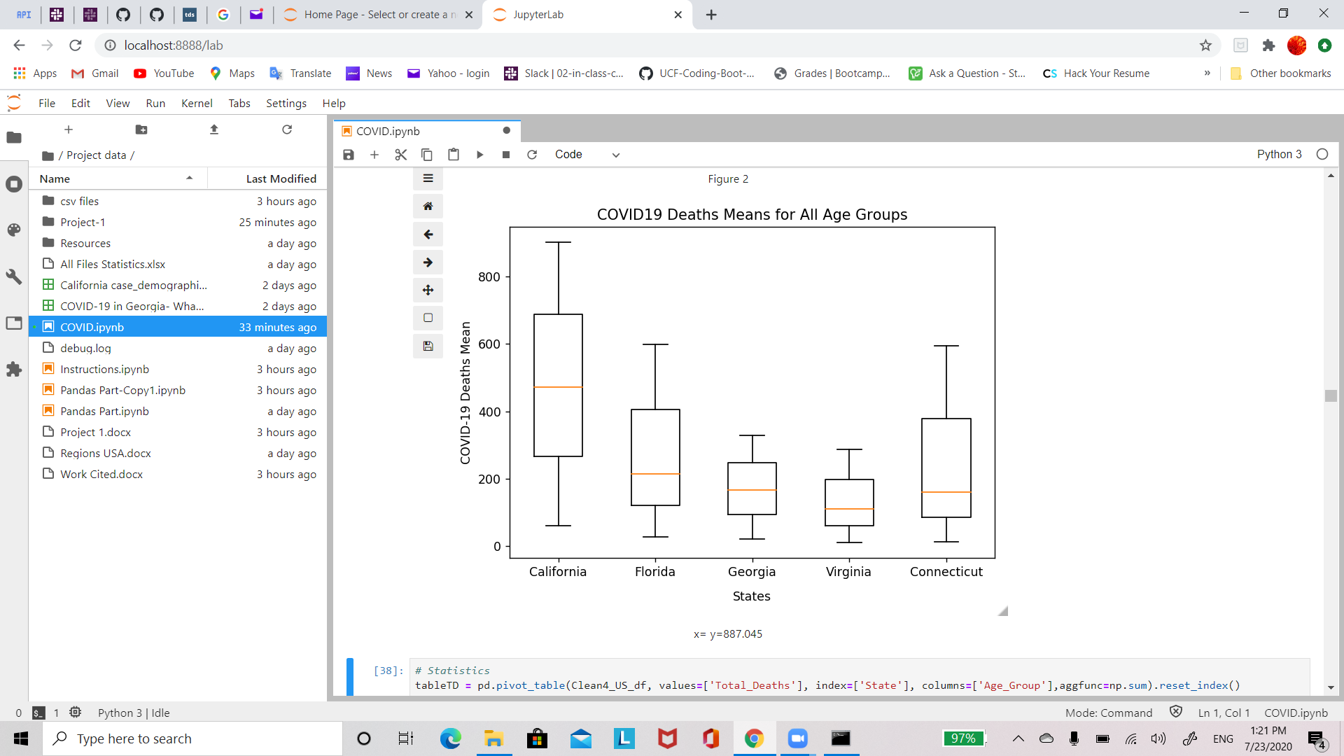
Box Plot
California
0-54 years 60.666667
55-64 years 472.000000
65 years and older 902.833333
Florida
0-54 years 28.363636
55-64 years 214.000000
65 years and older 598.500000
Georgia
0-54 years 22.200000
55-64 years 166.500000
65 years and older 329.833333
Virginia
0-54 years 10.727273
55-64 years 110.000000
65 years and older 287.333333
Connecticut
0-54 years 12.333333
55-64 years 161.000000
65 years and older 595.666667

Slide 26
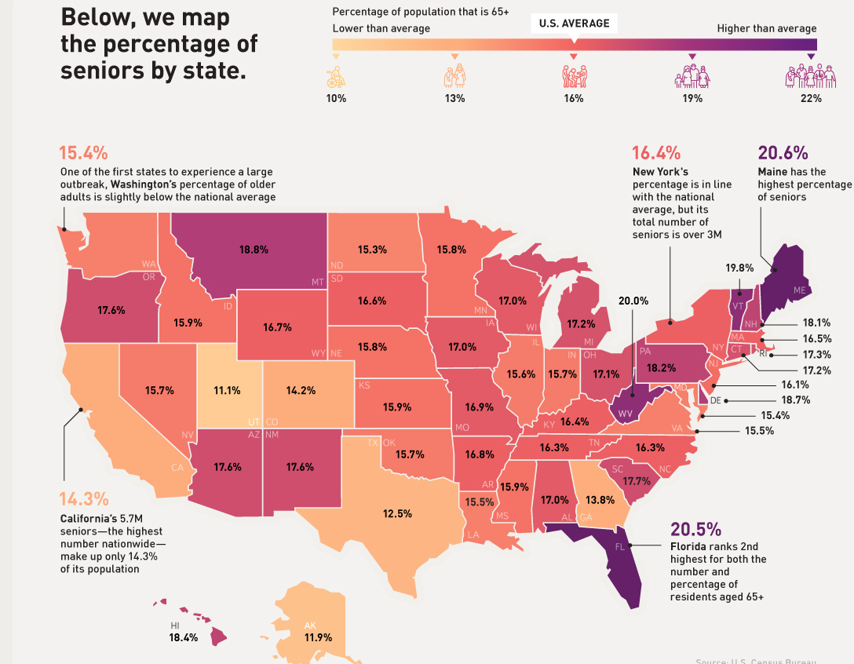

Potential for future work

Slide 27

Data sets used
THANK YOU!
Questions?
All States: https://data.cdc.gov/NCHS/Provisional-COVID-19-Death-Counts-by-Sex-Age-and-S/9bhg-hcku
Connecticut: https://data.ct.gov/Health-and-Human-Services/COVID-19-Cases-and-Deaths-by-Age-Group/ypz6-8qyf
California: https://data.ca.gov/dataset/covid-19-cases/resource/339d1c4d-77ab-44a2-9b40-745e64e335f2
Georgia: https://dph.georgia.gov/covid-19-daily-status-report
Virginia: https://www.vdh.virginia.gov/coronavirus/#COVID-19-resources
Florida: https://heavy.com/news/2020/07/florida-covid-19-death-rate-by-age/
Covid-19 Data Sources: https://www.wunderground.com/lite-content/en-US/coronavirus/sources
Map: https://www.visualcapitalist.com/mapped-us-senior-population-covid-19/

